Slide 1
Fall 2020 Writing and 2nd Language Support @VIU All online
John Hill, Writing Centre
Sylvia Arnold, International Academic Support (IAS)
Notes:
.

Slide 2
What is the Writing Centre?
The VIU Writing Centre provides support to all university writers in their intellectual endeavours.
For the typical student that means we assist you to make your assignments reflect your ideas effectively. We like to consider ourselves the Writing and Thinking Centre.

Slide 3
What does the Writing Centre do?
We can help you with a range of activities depending on your wishes:
You could come right at the start of your process, merely with the prof’s assignment description, and we would discuss with you how to proceed.
You might want help crafting a thesis statement.
Perhaps you are unclear about how to cite your sources using APA, MLA, or Chicago styles. We can help with that.
Perhaps you find it hard to construct grammatically-correct sentences. We will help you correct them.
Maybe you have a draft of a paper that you would like some feedback on: clarity, structure, and so on.

Slide 4
What is International Academic Support (IAS)?
IAS helps international and second-language students improve their academic language skills.
Like the Writing Centre, we help with all aspects of the writing process, but we also offer additional second language support.

Slide 5
How are we the same? How are we different?
The Writing Centre
& IAS:
Writing and Thinking
IAS:
Additional 2nd Language Support
Interpreting the question
Organising your paper
Citation
Reading complex texts
Generating a thesis statement
Grammar
Presentation content & design
Pronunciation
Listening strategies
Discussion skills
Vocabulary building
IELTS prep
Any 2nd language question!
ESL-specific grammar
Presentation delivery

Slide 6
Who are we?
All our tutors are VIU faculty.
Writing Centre tutors are generally professors in academic programs at VIU.
Coordinator: Dr. John Hill
john.hill@viu.ca
IAS tutors are English for Academic Purposes instructors in the Faculty of International Education at VIU.
Coordinator: Sylvia Arnold
sylvia.arnold@viu.ca

Slide 7
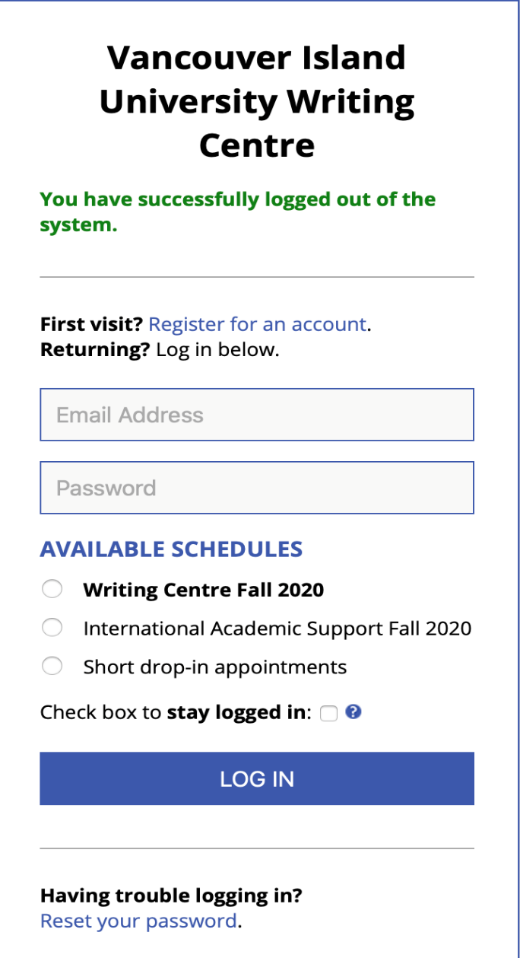
How do you access us?
Our physical premises are in the library (Writing Centre, fourth floor; IAS third floor). However, we are now and for the foreseeable future both operating as a wholly online service.
This is is the link to our shared booking system:
https://vancouver.mywconline.com/index.php?scode=NANF20
This is the log-in page.
See “first visit” above the email box. This will take you to a brief registration process.
The live link is available on each of our webpages on the university website.

Slide 8
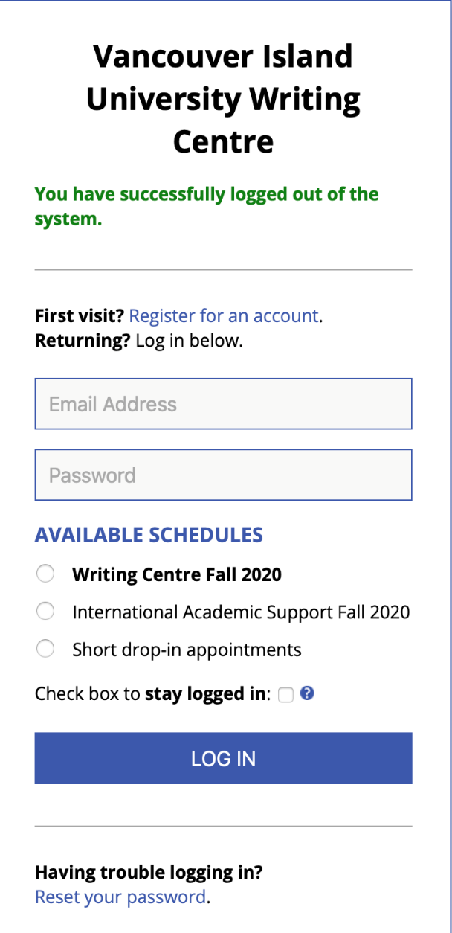
How do you log in?
The Writing Centre and IAS share an appointment system, but we have separate schedules.
Each time you log in, you must choose either the Writing Centre schedule or the International Academic Support Schedule.
(Or you can choose “Short drop-in appointments” for quick questions.)

Slide 9
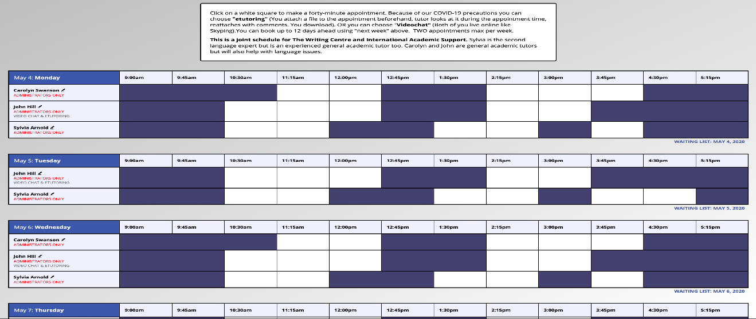
How do you book?
Once you have logged in, you will be able to access our schedules from any computer. See below
Choose a white (unbooked) square at a time that suits you and click on it.
A dialogue box will open. It will offer you a choice between “videochat,” a live skype-like experience, and “etutoring,” in which you attach your document to the appointment. Then we look at it and later reattach it to the appointment box with our comments.

Slide 10
What else do we offer?
Writing resource sheets online
Workshops
Weekly group: Boost Our Oral English
For details, see our websites: https://services.viu.ca/writing-centre
https://international.viu.ca/international-academic-support
Group (TBD)

Slide 11
That’s the Writing Centre & International Academic Support!
See us to …
Save time ☺
Reduce stress ☺
Improve your work ☺
Questions?
Writing Centre: john.hill@viu.ca
International Academic Support: sylvia.arnold@viu.ca

