Slide 1
Boost Your Oral English
An International Academic Support/ Writing Centre Workshop
January 12, 2021
Sylvia Arnold, Kate Weber, Suzy Nachtsheim

Slide 2
Oral (Spoken) English: Two Aspects
Fluency
Accuracy
Being able to make your point without stopping
Using accurate grammar,
pronunciation, and word choice

Slide 3
You: Fluency and Accuracy
Q1. Which is more important, fluency or accuracy?
Q2. On a scale of 1 (low) – 10 (high), how would your rate your oral
fluency?
Q3. On a scale of 1 (low) – 10 (high), how would your rate your oral
accuracy?

Slide 4
Fluency: How to Improve
Immerse yourself in an English speaking environment and take every opportunity to speak (this is the gold standard)
Find someone to chat with regularly
Talk to yourself regularly (Yes! This works.)
Key is focus on meaning. Don’t worry about accurate grammar, pronunciation, word choice.

Slide 5
https://capitalizemytitle.com/random-topic-generator/

Slide 6
Accuracy: How to Improve
Decide what specific aspect you want to improve and focus on it for a specific period of time (5 minutes/30 minutes/ in class)
e.g. grammar: using past tense correctly, using he/she correctly
e.g. pronunciation: putting stress on content words (nouns, verbs, adjectives, adverbs) in a sentence, pronouncing three key words
Find a partner to point out your mistakes (and successes!)
No partner? Record yourself and listen for mistakes (and successes!)

Slide 7
More on Accuracy
Correcting yourself is a good sign!
“When I was a child I play – I mean played – video games a lot.”
Pronunciation accuracy tip: focus on correct word stress of key terms.
CAnada vs CaNAdian
Q: Which syllable is stressed most in these words:
Analysis
Analyze
Academic
Industry
Project (n)
Variables

Slide 8
Answers!
analysis: anALysis
analyze: ANalyze
academic: AcaDEmic
industry: INdustry
project: PROject (n)
variables: VARiables
Idea: Choose 5-10 key terms in your field of study to perfect*.
*perFECT (verb form)

Slide 9
For Either Fluency or Accuracy …
Assess your current level
Choose a specific aspect to improve
Create a SMART goal
Book an appointment with
IAS to help with the above!
https://vancouver.mywconline.com/

Slide 10
Improving Academic Speaking
The Academic Spoken English Strategies Survey (ASESS) survey can help you become aware of speaking strategies to use in academic situations: file:///C:/Users/sylvi/OneDrive/Documents/IAS/I20%20workshops/Boost%20Your%20Oral%20English/ASESS%20Survey%20Speaking%20Only(2).pdf
Which strategies do you already use?
Which strategies do you want to try? → Make a SMART goal!
Thank you to C. Dawn Johnson, BEd, MA, EdD Candidate, for sharing this survey and for ideas about using it with students.

Slide 11
Helpful Resources
List of helpful websites: https://international.viu.ca/sites/default/files/lc_recommended_websites_s20.pdf
List of discussion language:
file:///C:/Users/sylvi/OneDrive/Documents/IAS/I20%20workshops/Boost%20Your%20Oral%20English/Discussion%20Tool%20Kit2020.pdf
Site for ideas on how to improve speaking on your own:
https://www.fluentu.com/blog/english/how-to-improve-spoken-english/
Wonderful international organization dedicated to public speaking support (join a group near you): https://www.toastmasters.org/
Random topic generator: https://capitalizemytitle.com/random-topic-generator/

Slide 12
To Sum Up …
+
Fluency and Accuracy are both important
Focussing on one OR the other at a time is most effective
Practice regularly (even on your own)
Check out the many strategies on the ASESS survey
Set SMART goals
Book an appointment with IAS for a speaking assessment and to help set and meet oral English SMART goals
And ….

Slide 13
Starts Monday, January 18th
And …

Slide 14
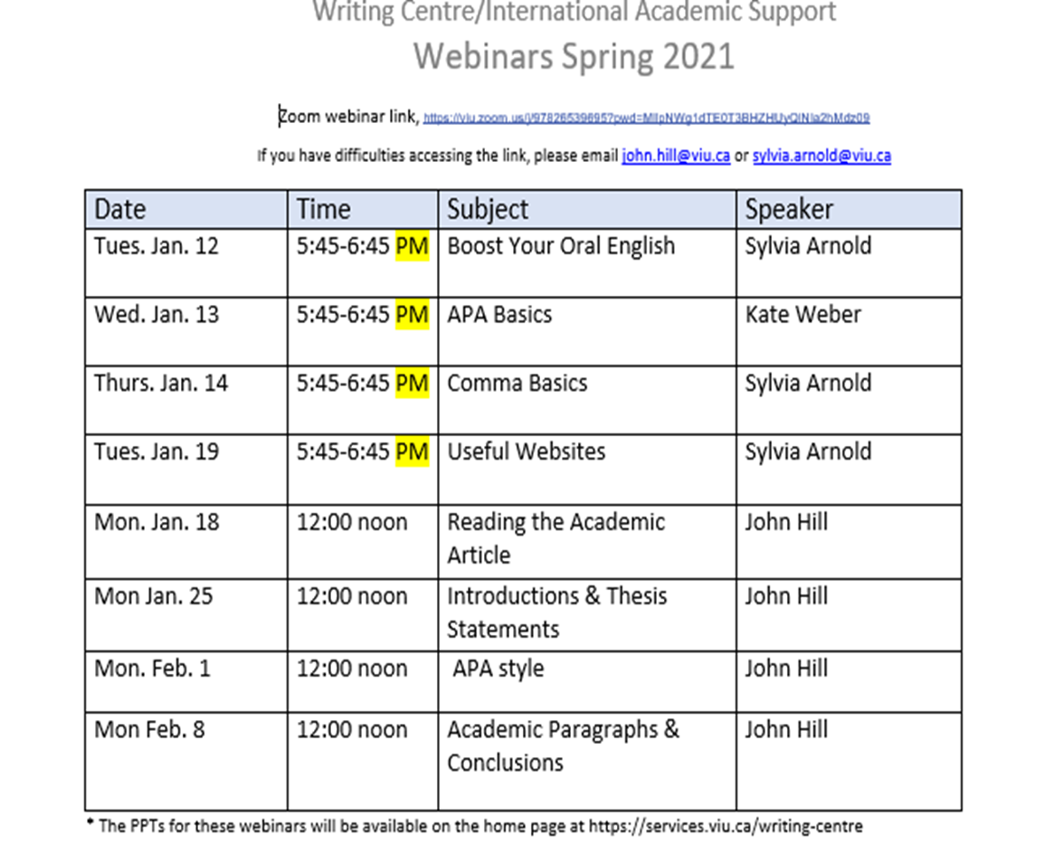

Slide 15
Thank you!
We look forward to working with you!
YOUR IAS team: Kate, Suzy, and Sylvia
Kate Weber, Suzy Nachtsheim, and Sylvia Arnold
+ Workshop feedback: anonymous poll
+ Questions?
More Questions: sylvia.arnold@viu.ca VIU International Academic Support

