Slide 1
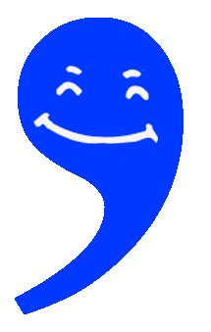
1-2-3: Comma Basics
An International Academic Support/ Writing Centre Workshop
Vancouver Island University
By Sylvia Arnold
January 14, 2021
Vancouver Island University
With references to https://services.viu.ca/sites/default/files/how_to_use_commas.pdf

Slide 2
First off, why commas?
“Used correctly, commas are useful guides to how to read a sentence;
… used wrongly, they can trip a reader up.”
-- John Hill, VIU Writing Centre Coordinator

Slide 3
Q. Which punctuation mark is easier to explain?
1. The Comma?
Or 2. The semicolon?

Slide 4
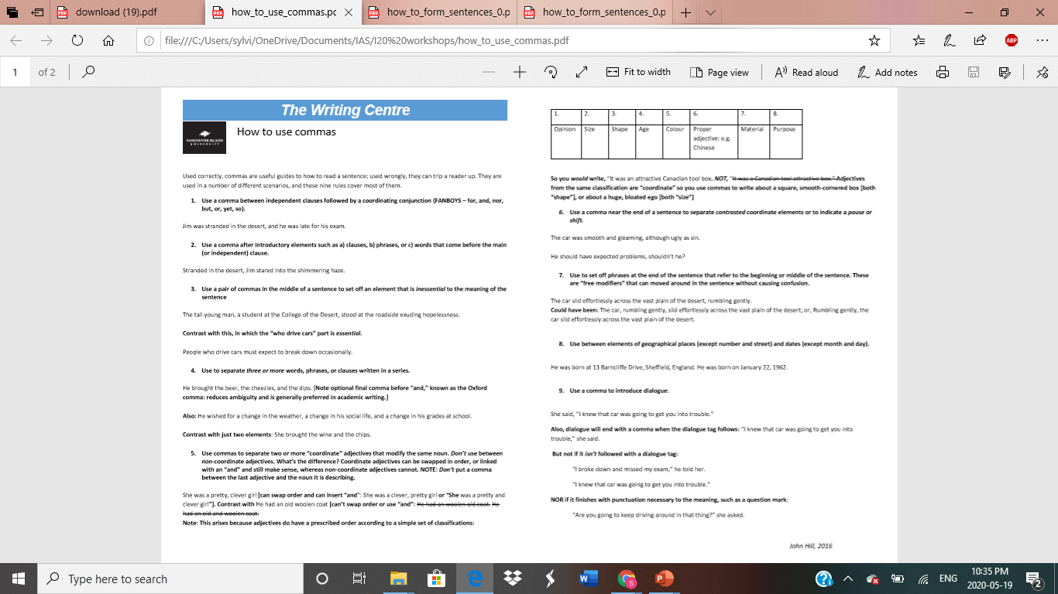
A: Hands down it’s …
X The comma
The semicolon
9+ rules, all fairly common
Rule #1(~95% of the time)
+ Rule #2 (you got it …~5% of the time)

Slide 5
Nine rules!! Today, I will focus on three, the basics.
Use a comma between independent clauses followed by a coordinating conjunction (FANBOYS – for, and, nor, but, or, yet, so).
This rule will take a number of slides to explain. Bear with me!
2. Use a comma after words that come before the independent clause.
3. Use a comma to separate three or more items in a series.

Slide 6
To understand commas, let’s first look at semicolon rule #1 (the ~ 95%-of-the-time rule).
# 1. Use a semicolon between two independent clauses:
Jim studied hard for his exam; he passed it.
What’s an independent clause you ask? Subject + Verb + complete idea.
IMPORTANT: Every* sentence MUST have at least one independent clause.
*Unless you’re writing an ad, a text message, a novel, a poem, or in any situation in which you can say “rules, what rules?” or “bah, rules…”

Slide 7
Q: Why do you think I chose green as the colour for an independent clause?

Slide 8
A: Green means “Go” or “Yes”!
Green means yes, this IS an independent clause. The clause says,
“I can stand alone. I am independent.”
Jim studied hard for his exam.
He passed it.

Slide 9
A key point to remember is this …
A semicolon and a period (aka a full stop) are close cousins, both strong.
Jim studied hard for his exam; he passed it.
Jim studied hard for his exam. He passed it.
A comma is a very distant cousin and is weak.
X Jim studied hard for his exam, he passed it. = comma splice (yikes!!!)
And if you have no punctuation at all between the two, you have a run-on sentence, (yikes!!!): X Jim studied hard for his exam he passed it.

Slide 10
To put it another way, before we get to the first rule of commas, there is a do-NOT rule:
Do NOT* use a comma to join two independent clauses.
X Jim studied hard for his exam, he passed it. = a comma splice (yikes!!!)
*Unless, again, you’re writing an ad, a text message, a poem …

Slide 11
BUT you CAN join two independent clauses with a comma IF you ALSO add a FANBOYS* word:
a comma + a FANBOYS word
Jim studied hard for his exam,so he passed it.
,for
,and
,nor
,but
,or
,yet
,so
*FANBOYS, aka coordinating conjunctions →
(when used between two independent clauses)
BOTH a comma AND a FANBOYS word are needed!

Slide 12
Thus, (finally!) comma rule #1 is …
Use a comma between independent clauses followed by a coordinating conjunction (FANBOYS – for, and, nor, but, or, yet, so).
Jim studied hard for his exam,so he passed it.
Jim didn’t study hard for his exam,but he passed it.
(Plus, do NOT join independent clauses with only a comma!)

Slide 13
Let’s practice comma rule #1:
Which is/are correct?
Aya likes fitness classes she bought a rec centre membership.
Aya likes fitness classes, so she bought a rec centre membership.
Aya likes fitness classes, she bought a rec centre membership.
Aya likes fitness classes; she bought a rec centre membership.
Answer: 2 & 4

Slide 14
More practice with rule #1:
A. What about these two?
Aya likes fitness classes and bought a rec centre membership.
Aya likes fitness classes, and bought a rec centre membership.
Aya likes fitness classes, and she bought a rec centre membership.
B. And these two?
Using commas effectively will help you stand out from the crowd for most people do not use them properly.
Using commas effectively will help you stand out from the crowd, for most people do not use them properly.
Answers: A1, B2

Slide 15
Comma Rule #2: Use a comma after words that come before the independent clause.
Stranded in the desert, Jim stared into the shimmering haze.
Q: Why do you think I chose pink as a colour for the words before the independent clause?

Slide 16
A: Pink is the closest highlighting colour to red, meaning “NO!”
Pink means this is NOT an independent clause.
Because Jim was stranded in the desert,(dependent clause)
Stranded in the desert, phrase
In the desert, phrase (prepositional)
Wearily, (word)
The words say “I CANNOT stand alone…

Slide 17
…I must be joined with an independent clause.”
Because Jim was stranded in the desert, he stared into the shimmering haze.
Stranded in the desert, Jim stared into the shimmering haze.
In the desert, Jim stared into the shimmering haze.
Wearily, Jim stared into the shimmering haze.
(“Please, please don’t leave me alone. If you do, I’m a sentence fragment. Yikes!!!!”)

Slide 18
Let’s practice comma rule #2:
Which is/are correct?
Because Aya liked fitness classes she bought rec centre membership.
Because Aya liked fitness classes, she bought a rec centre membership.
Liking fitness classes Aya bought a rec centre membership.
An enthusiast of fitness classes, Aya bought a rec centre membership.
Answer: 2 & 4

Slide 19
More practice with rule #2:
How about these two?
Because Aya liked fitness classes, she bought a gym membership.
Aya bought a gym membership, because she liked fitness classes.
Answer: 1

Slide 20
Fun Fact about dependent clauses:
If they come before the independent clause, they are followed by a comma: (You knew that because it’s comma rule #2…)
Because Aya liked swimming ,she bought a gym membership.
BUT if they come after the independent clause, there is NO comma:
Aya bought a gym membership because she liked swimming.

Slide 21
Comma rule # 3:Use a comma to separate three or more items in a series.
He brought the beer, the Cheezies, and the dips.
BUT do not use a comma if it’s only two items in a series.
She brought the wine and the chips.
[Note optional final comma before “and,” known as the Oxford comma: it reduces ambiguity and is generally preferred in academic writing.]

Slide 22
Comma rule #3 cont’d: The items in the series can be …
a list of words:
He brought the beer, the Cheezies, and the dips.
a list of phrases:
He wished for a change in the weather, a change in his social life, and a change in his grades at school.
a list of clauses (not as common)
He went to the party because he wanted to dance, he hoped to eat Cheezies, and he hoped to find a love interest.

Slide 23
Let’s practice comma rule #3
Which is/are correct?
They are interested in sex, drugs, rock.
They are interested in sex, drugs, and rock.
They are interested in sex, drugs and rock.
Answer: 2 & 3 (but 2 preferred)

Slide 24
More practice with comma rule #3
How about these?
They are interested in sex, drugs, rock and roll.
They are interested in sex, drugs, and rock and roll.
They are interested in sex, drugs, rock, and roll.
They are interested in sex, drugs and rock and roll.
Answer: 2 & 4, but 2 preferred

Slide 25
Even more practice with rule #3
And these two?
In order to be better writers, students should learn the basics of sentence structure and punctuation, the main essay formats, and the methods of effective revision.
In order to be better writers, students should learn the basics of sentence structure and punctuation, the main essay formats, the methods of effective revision.
Answer: 1

Slide 26
1-2-3 Practice
This passage has no commas. Add them where needed.
Sylvia gave a presentation about the basics of comma use and she gave some practice exercises. Before talking about commas she talked about semicolons. The presentation is just the beginning. In order to really learn how to use commas students need to know which rule(s) they have trouble with to pay close attention to their use of that rule and to get feedback and encouragement on their progress.

Slide 27
1-2-3 Answers
Sylvia gave a presentation about the basics of comma use, and she gave some practice exercises. Before talking about commas, she talked about semicolons. The presentation is just the beginning. In order to really learn how to use commas, students need to know which rule(s) they have trouble with, pay close attention to their use of that rule, and get feedback and encouragement on their progress.

Slide 28
To recap, the basics of comma use are …
Use a comma between independent clauses followed by a coordinating conjunction (FANBOYS – for, and, nor, but, or, yet, so).
Use a comma after words that come before the independent clause.
Use a comma to separate three or more items in a series.

Slide 29
Next steps:
Check out the Writing Centre’s comprehensive NINE-rule handout on commas: https://services.viu.ca/sites/default/files/how_to_use_commas.pdf
Get feedback (and encouragement!) on improving your comma use from a Writing Centre or International Academic Support faculty tutor: https://vancouver.mywconline.com/
Questions or suggestions? sylvia.arnold@viu.ca
Good Luck! (Actually, it’s not luck. It’s attention, perseverance, and yet more attention…)

