Slide 1
How to write a summary & A reflection
An International Academic Support (IAS) workshop
Spring 2022 Rita Mizuno

Slide 2
How to write a summary
https://viuvideos.viu.ca/media/How+to+Write+a+Summary/0_mrcjfi37

Slide 3
Let’s practice summary writing ☺
Practice #1
https://www.englishdaily626.com/summary.php?023
This Photo by Unknown Author is licensed under CC BY-SA-NC

Slide 4
Summary practice #2 – summarize each paragraph in ONE sentence Basic-level Paraphrase and Summary Writing // Purdue Writing Lab

Slide 5
For additional practice, try the exercises in this link: https://academicintegrity.uoguelph.ca/plagiarism/paraphrasing-and-summarizing-practice-exercise

Slide 6
How to write a reflection
https://viuvideos.viu.ca/media/Reflective+writing/0_yzoolonb

Slide 7
Reviewing the elements of reflective writing – part I
Short-Guide-Reflective-Writing.pdf (birmingham.ac.uk)
This Photo by Unknown Author is licensed under CC BY

Slide 8
Reviewing the elements of reflective writing – part II
How to Write a Reflection Paper - Academic Skills - Trent University

Slide 11
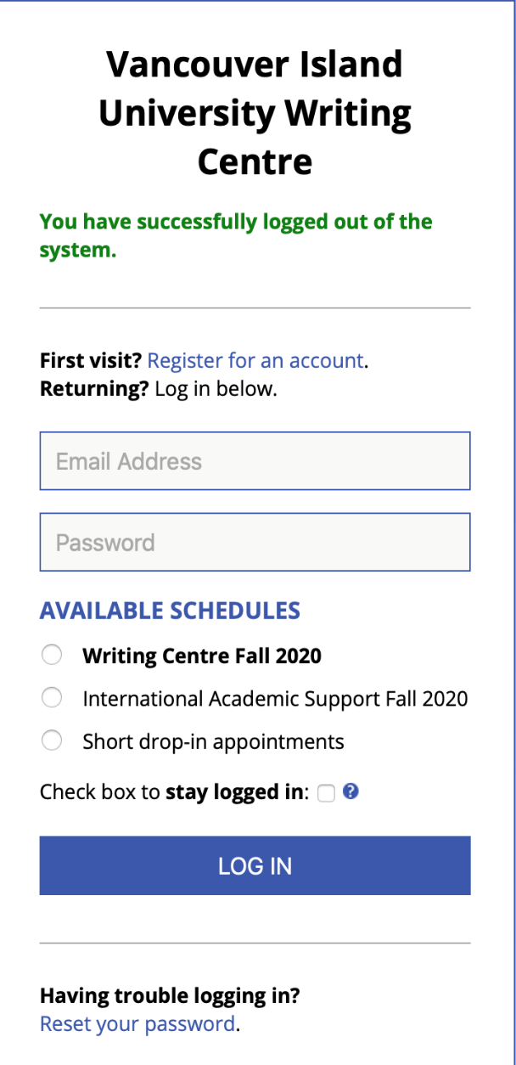
The Writing Centre and IAS share an appointment system.

Slide 12
Step 1: Choose TUTOR TYPE:
‘a’ tutors are VIU professors
‘b’ tutors are International Academic Support (IAS) tutors who have training in ESL
Both types of tutors can assist any student with their academic writing, but ‘b’ (IAS) tutors can further support students with English language learning issues.
Step 2: Choose ONE of 3 TUTORING MODES:
1. F2F = Face-to-face (in person) tutoring in the Writing Centre, 4th floor of the VIU Library
2. Online: you will be given TWO options:
Videochat (meet live online, like Skyping, accessed by clicking on the appointment box).
etutoring (attach a Word document (not PDF) to receive email feedback; be specific about what you would like feedback on. Provide prof’s assignment details if possible).

Slide 13
Thanks, eh?
Your IAS team (Rita & Kate)
+
the other Writing Centre tutors
look forward to working with you!
+ Workshop feedback
+ Questions?
+ More Questions: rita.mizuno@viu.ca

