Slide 1
The art of Paraphrasing
Why and How
International Academic Support (IAS) Workshop
Rita Mizuno (IAS tutor)

Slide 2
Are you familiar with these keywords? sources referencing (reference) citing (citation)
What are the benefits of adding outside sources to your writing?
John Hill, Writing Centre Coordinator, often says that your reader wants to know:
How do you know that?
Why should I believe you or agree with you?
How can I find out more about that?

Slide 3
How about this keyword? plagiarism
Using the words/thoughts of another as your own.
From the Latin word, “kidnapping.” It is stealing “intellectual property.” It is a serious act of academic misconduct!
You don’t have to cite “common knowledge,” but you do have to cite other people’s intellectual property.
Your reader needs to see the difference between your ideas and words and your source’s ideas and words.

Slide 4
The challenge: How do you use sources to strengthen your arguments but not commit plagiarism?
1) Identify your source.
2) Focus on the source’s ideas more than their words.
3) Paraphrase or summarize the source in a way
that is very different from the original.

Slide 5
More keywords. How are they different? quote, paraphrase, and summarize (summary)
Original [written by Tom Jones in 2015, on page 3]: The majority of the media are liars and anyone who blindly follows them is ignorant.
Quote: Jones (2015) stated, “The majority of the media are liars and
anyone who blindly follows them is ignorant” (p. 3).
Paraphrase: According to Jones (2015), intelligent people should be
aware that many journalists do not tell the truth.
Summary: Jones (2015) argued it is foolish to completely trust the
media.

Slide 6
Important note about summarizing vs. paraphrasing (by John Hill, the Writing Centre Coordinator)
Don’ts ☹
Do’s ☺
Paraphrasing is a useful linguistic skill, but it is not necessarily a useful intellectual one, for you or your reader. Simply to take another’s sentence and then struggle to “make it your own” in an odd process of word substitution achieves little, and often results in a worse sentence that may even badly reflect some of the subtleties of meaning in the original.
Instead, read the text you are using with the goal of understanding it so that you can then explain or make sense of the original through meaningful (and useful) summary. Aim to produce your summarizing/ explanatory sentences from larger chunks of text than sentences: paragraphs, sections. You are effectively talking about your sources rather than talking through them. You are still citing their ideas as you explain them, however. Think about how you would talk to a friend about the work in question if they asked you what it was about and how the authors supported their argument. If you cannot escape the form of the sentence you need, perhaps this is a time for a quotation.

Slide 7
How to identify your source
Give the LAST name, DATE (year of publication) and, if quoting, page or paragraph number.
APA prefers past tense reporting verbs. Use different verbs: stated, noted, pointed out, argued, emphasized, learned, found, determined, etc.
Integral citations (author name part of the sentence):
Jones (2021) said that interest rates had increased by 10%.
Jones (2021) said, “Interest rates rose by 10%” (p. 4).
According to Jones (2021), interest rates had increased by 10%. According to Jones (2021), “Interest rates rose by 10%” (para. 6).
Non-integral citations (author name in brackets):
Interest rates had increased by 10% (Jones, 2021).
“Interest rates rose by 10%” (Jones, 2021, p. 4).

Slide 8
How about these keywords? synonym, antonym, and thesaurus
synonym: words with the same meaning
antonym: words with the opposite meaning
thesaurus: a resource to find synonyms and antonyms of words e.g. https://www.thesaurus.com/

Slide 9
Paraphrasing/Summarizing Techniques
Focus on the IDEA from your reference more than on the words.
Read the source and take notes in your own words. Ask yourself questions about the ideas.
In your own words, explain the writer’s idea without looking at the original.

Slide 10
3 Common Paraphrasing Techniques
1) Use synonyms or antonyms (use your own words/words that you know!)
George is incredibly chivalrous to exquisite members of the opposite sex.
George is very polite to pretty girls.
George is never rude to pretty girls.
2) Change word forms
She is full of energy!
She is energetic! (noun -> adjective)
He teaches my class.
He is my class teacher. (verb -> noun)
That movie threw me into a state of depression.
That movie depressed me. (prepositional phrase -> verb)
The storm caused a lot of damage to the property.
The storm caused a lot of property damage. (prepositional phrase -> adjective phrase)

Slide 11
Technique #3 (most important!!!!)
3) Change sentence structure: clauses, phrases, voice, order, length…
The act of carelessly discarding one lighted cigarette in the forest started the largest fire that had ever occurred in that region resulting in the destruction of hundreds of homes.
The act of carelessly discarding one lighted cigarette in the forest started the largest fire that had ever occurred in that region resulting in the destruction of hundreds of homes.
The worst forest fire in the history of that region was started by a single cigarette someone dropped. Due to this thoughtlessness, hundreds of homes were destroyed.

Slide 12
Using the source’s original words
Sometimes, you may want to keep quote the original words from your reference when the wording is special and will add a greater impact to your paper than normal expressions would. For example:
American civil rights leader, Dr. Martin Luther King, Jr. (1965) said, “The function of education is to teach one to think intensively and to think critically. Intelligence plus character – that is the goal of true education” (p. 2).
You could paraphrase his idea but keep the interesting expression, “intelligence plus character” with a blend of paraphrasing and quoting:
Dr. Martin Luther King, Jr. (1965) noted that educators should train students to think deeply so that they develop “intelligence plus character” (p. 2).

Slide 13
Practice Summarizing
Read the original source, then answer the questions about the story.
Smith, E. (2015). The power of positive thinking. Journal of Applied Developmental Psychology, 30(5), 22. https://doi.org/11.1017/j.appdev.2015.05.005
Some people can stay happy even under stressful circumstances. One of my co-workers, Mr. Johnson, is a good example of this type of person. He always seems to take a positive view toward life. I recall one incident in particular that illustrates this point. Johnson told me he usually gets up at 6:30, but one day he woke up, looked at his alarm clock, and was shocked to see that it was already 7:30! He said he must have forgotten to set it the night before and had overslept. He jumped out of bed, washed up, shaved, and got dressed quickly. He was hungry, but there was no time for breakfast. He ran all the way to the station and was able to board the next train.
Fortunately, he arrived at the company by the 9:00 start time. He said good morning to his fellow workers and stopped by the staff kitchen to make himself a cup of coffee, nice and hot. He recalled that it smelled so good. Then, he made his way over to his office, sat down, and put his head on this desk. In less than a minute, he was snoring and starting to enjoy a very pleasant dream. He later told me his dream was about having a nice breakfast at his favourite coffee shop and that when he woke up, he wasn’t hungry anymore, but was energized and he had had a very productive day after all! He is a classic case of the positive thinker who refuses to dwell on the negative, who effortlessly turns lemons into lemonade.

Slide 14
Answer these questions in full sentences
1. Did the man wake up early or late this morning?
2. How did he get ready for work, quickly or slowly?
3. Did he run or walk to the train station?
4. Did he catch his train?
5. Did he make it to work on time or was he late?
6. Did he greet his co-workers?
7. What did he make and where did he go?
8. Where did he immediately fall asleep?
9. What did he later say he had been dreaming about eating?
10. How did he feel when he woke up and how was the rest of his day after that?

Slide 15
Summary of the Story
Smith, E. (2015) argued that a positive attitude makes a big difference in how people cope with stress. He gave an example with a story about one of his co-workers: One day, the man woke up late and quickly got ready for work. He ran to the train station and caught his train. He made it to work on time and greeted his co-workers cheerfully. He made a cup of coffee, went to his office, and immediately fell asleep at his desk. He later said he had been dreaming of eating the breakfast he had missed and that he woke up refreshed and ready to work! Smith concluded that this positive attitude is what makes it possible for people to “turn lemons into lemonade” (p. 22).

Slide 16
In Conclusion
Don’t just change words/word forms but make sure you also change the sentence structure so your sentence looks completely different from the original. Poor paraphrasing is a form of plagiarism.
Good and bad examples of paraphrasing
https://academicguides.waldenu.edu/writingcenter/evidence/paraphrase/examples
https://www.lib.uwo.ca/tutorials/paraphrasing/index.html
https://www.muhlenberg.edu/academics/psychology/studentportal/inappropriateparaphrasing/
https://eltc-language-resources.group.shef.ac.uk/lessons/identifying-good-and-bad-paraphrases/ [students to do after the WS]
Even better, summarize rather than just paraphrase. Focus on the ideas, not the words.
Remember the purpose for citing a source in your paper. An authoritative source adds strength to your claim but only when you use YOUR words to support YOUR ideas.

Slide 19
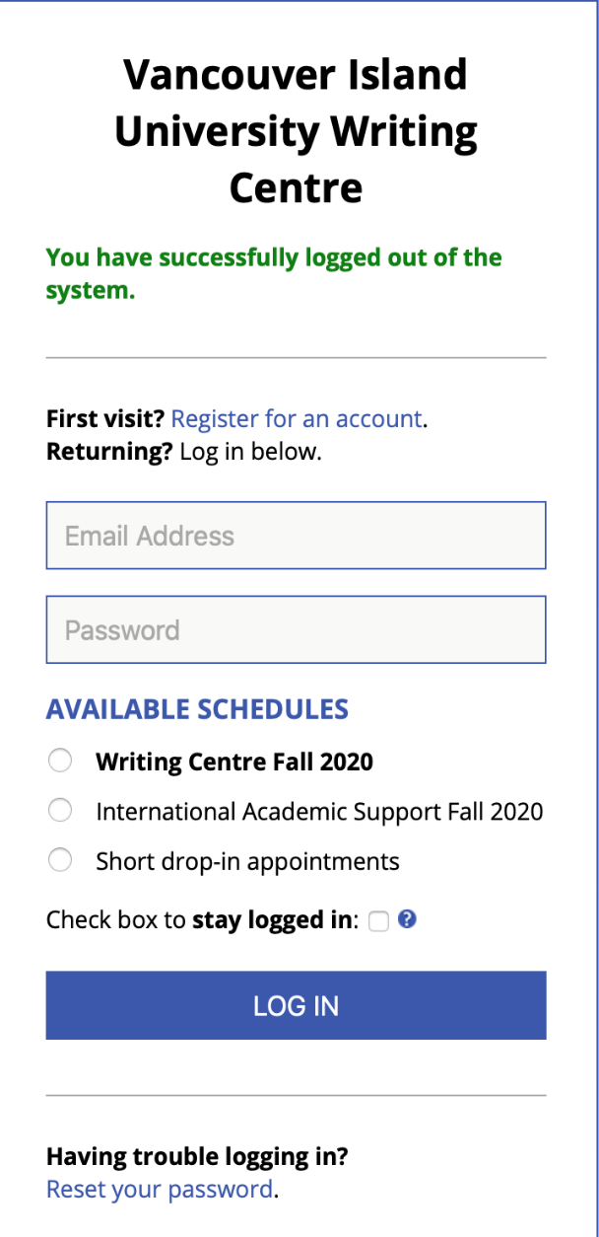
The Writing Centre and IAS share an appointment system.

Slide 20
Step 1: Choose TUTOR TYPE:
‘a’ tutors are VIU professors
‘b’ tutors are International Academic Support (IAS) tutors who have training in ESL
Both types of tutors can assist any student with their academic writing, but ‘b’ (IAS) tutors can further support students with English language learning issues.
Step 2: Choose ONE of 3 TUTORING MODES:
1. F2F = Face-to-face (in person) tutoring in the Writing Centre, 4th floor of the VIU Library
2. Online: you will be given TWO options:
Videochat (meet live online, like Skyping, accessed by clicking on the appointment box).
etutoring (attach a Word document (not PDF) to receive email feedback; be specific about what you would like feedback on. Provide prof’s assignment details if possible).

Slide 21
Thanks, eh?
Your IAS team (Rita & Kate)
+
the other Writing Centre tutors
look forward to working with you!
+ Workshop feedback
+ Questions? rita.mizuno@viu.ca
+ https://www.viu.ca/ias

