Slide 1
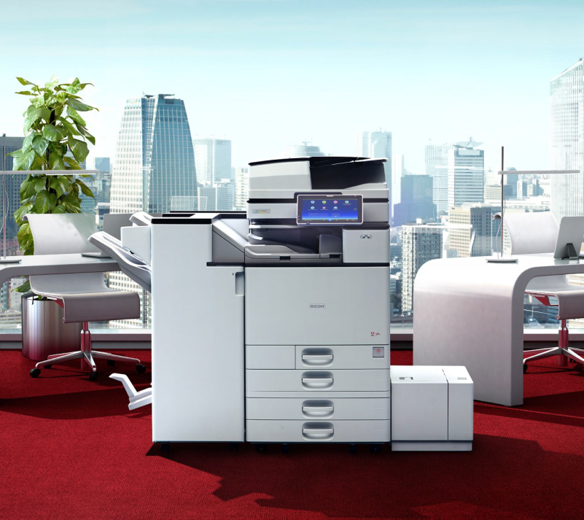
Ricoh
PaperCut &
Device
Training
Ricoh Canada Inc.
13/09/2019

Slide 2
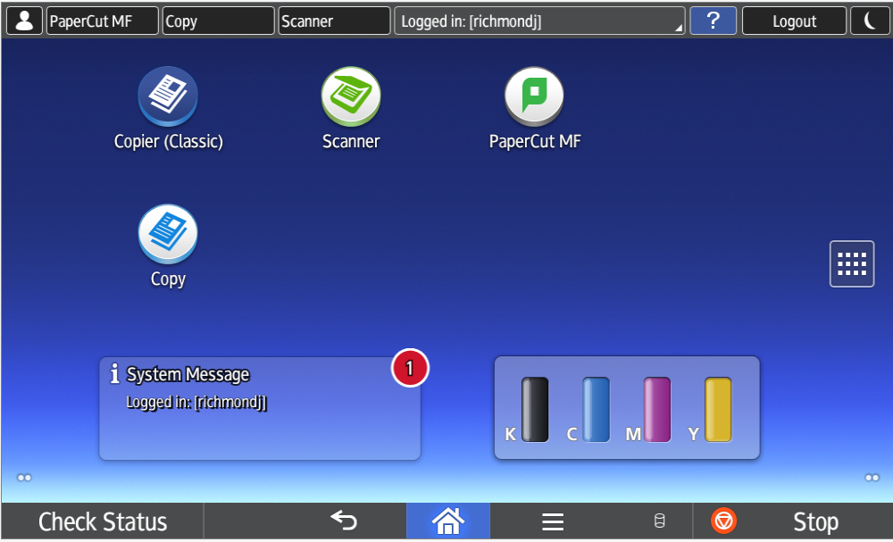
Welcome to PaperCut
... your new eco-friendly print software

Slide 3
Agenda
Activating Your Card
Print to Me
Scan to Me
Ricoh Scan
Copy
Global Scan Right Fax
Status / Misfeeds / Maintenance

Slide 4
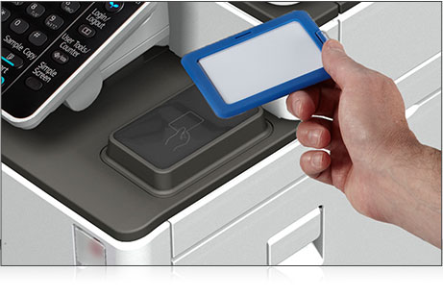
Activating Your Card
02292011229787-1

Slide 5
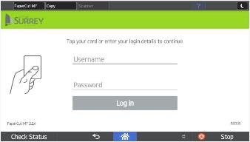
Activating your card
Step 1
Tap your Access Card over the card reader on your Ricoh device. The screen will read,
Associate your card with a user account by entering in your login details.
Press Username to associate your card with an account
This is a one time process.

Slide 6
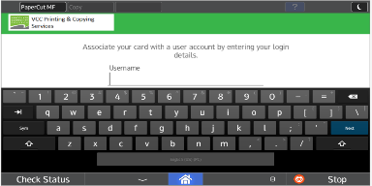
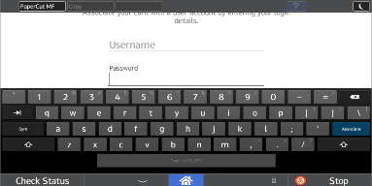
Activating your card
Step 2
Enter your Network Username and Press Next
Enter you Network Password
Step 3
Press Associate on the touch screen.
.

Slide 7
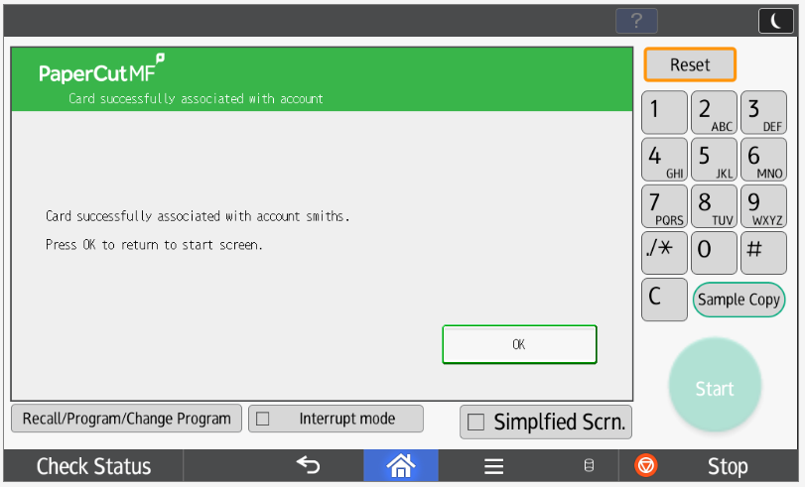
Activating your card
Step 4
If Network information is entered correctly it will say that your “Card is successfully associated with account”.
Press OK on the touch screen to proceed.
Tap card again to access Print Release, Device Functions and Scan
If your card doesn’t associate, re-tap your card and enter network username and password again.

Slide 8
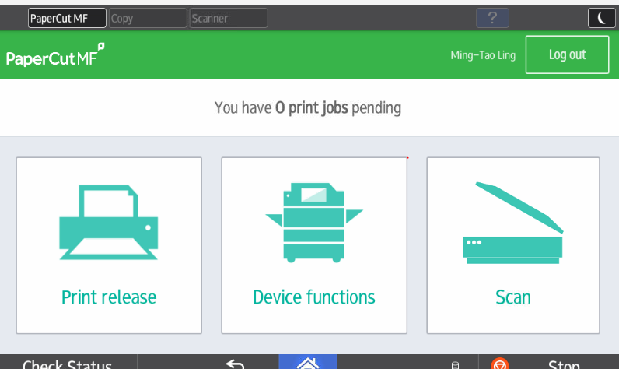
Login and Logout
Once your card is activated, you can go to any Ricoh device in your office to Log In and release your Print jobs, use Device Functions and Scan.
Don’t Forget To Log out by pressing the Logout button
at the top right of the screen or swipe your card on the reader or it will log you out automatically after 60 seconds.

Slide 9
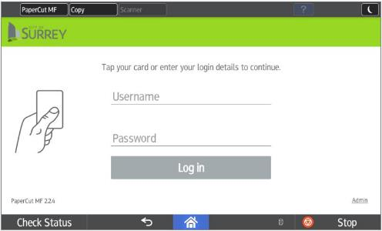
Forgot Your Card?
If you forget or lose your card, you can manually login with your network authentication.
Enter your username in the Username field, then in the Password field and press Log in.

Slide 10
Using Print To Me

Slide 11
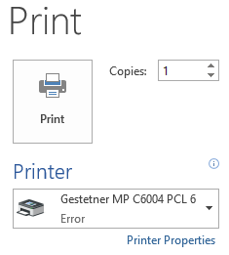
Print to Me Printing
Select your ‘Print To Me’ print queue.
Print To Me Queue

Slide 12
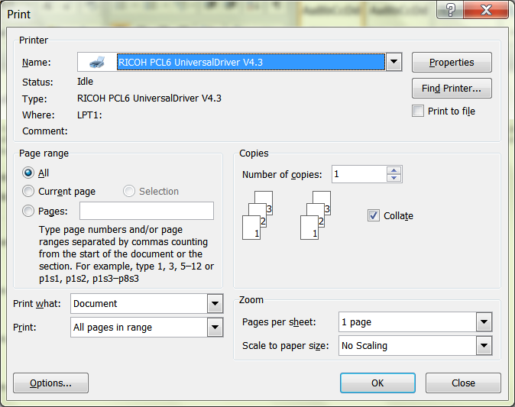
Print Driver
Open your document, click on File and Print. Select the Print to Me printer, if it is not your default, and click on Properties or Preferences depending on the application to get into the Ricoh driver.

Slide 13
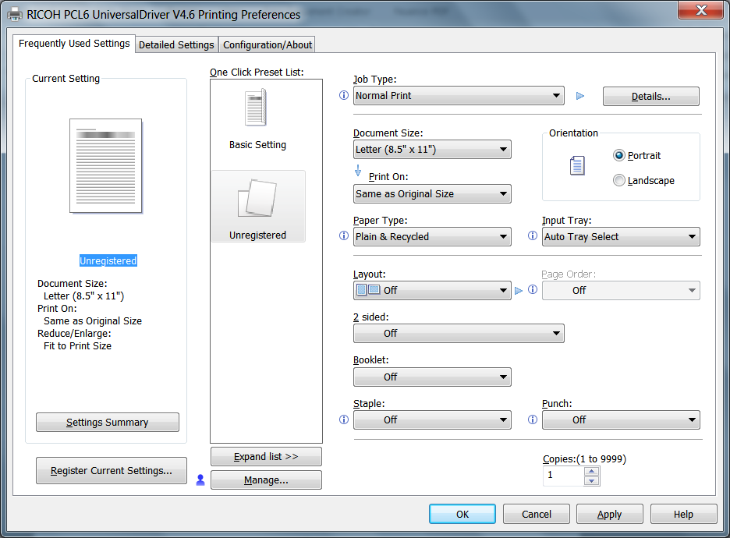
Frequent Settings
Frequently Used settings
Document Size
Portrait or Landscape
Paper Type
Input Tray
Layout
2-Sided
Booklet - Magazine
Staple
Punch
Color/Black and White
You can make One Click Presets by picking the features and then click Register Current Settings.

Slide 14
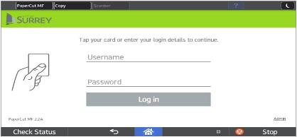
Print To Me Printing
Step 1
Tap your card on the reader at the Ricoh device.
OR
If you forgot your card you will need to authenticate manually, enter your Username and Password and press Log in.

Slide 15
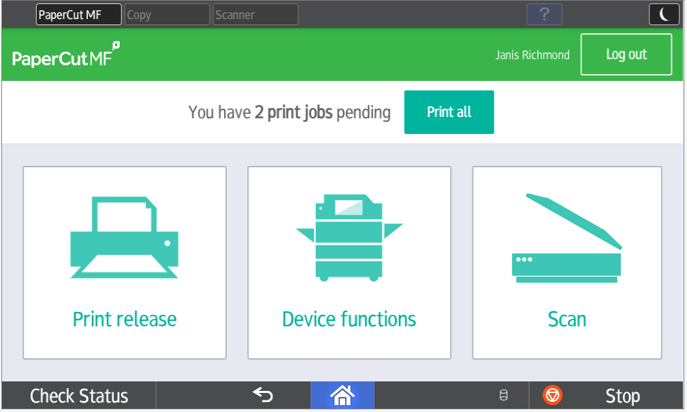
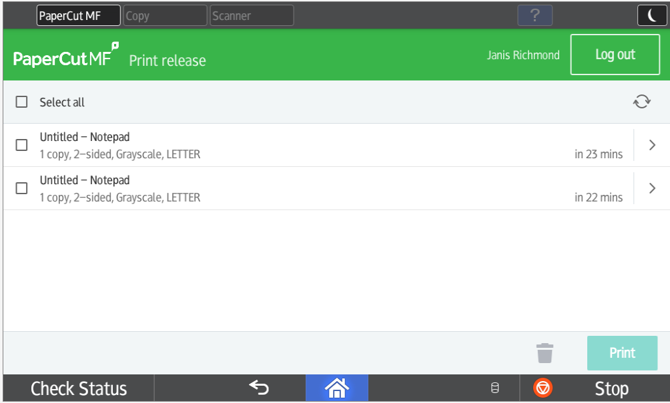
Print To Me Printing – Print Release
Step 2
You can press Print All to release all jobs or press Print release - you will notice your print jobs queued up ready for release. Select your print jobs and press Print.
To delete a print job select the print jobs then press the garbage can icon.

Slide 16
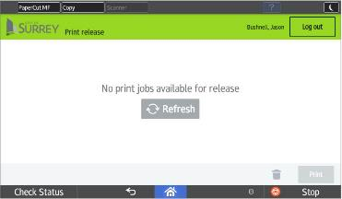
Print To Me Printing – Logging Out
Step 3
Press the Log out button at the top of the screen, or tap your card on reader to log out.
If you forget to logout PaperCut will log out after 60 seconds or if another person taps their card they will log you out.

Slide 17
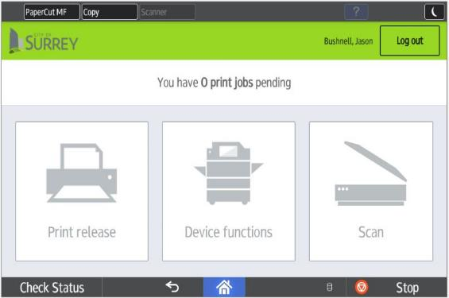
Check Status - Correcting a Print Job Error
When the red light under Check Status is highlighted, touch the icon to resolve the problem. Opposite the function, the unit indicates the reason for the error.

Slide 18
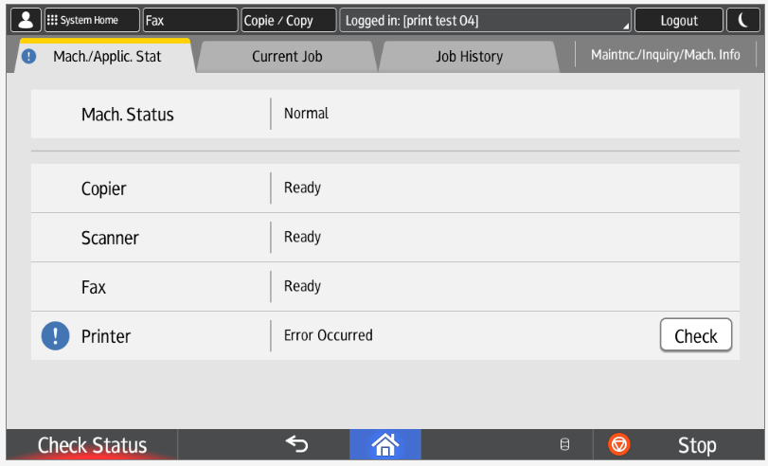
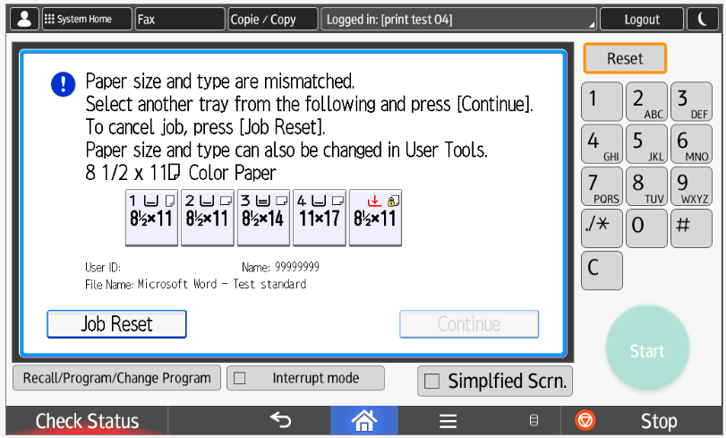
Check Status - Correcting a Print Job Error
When you are in the Check Status menu, click on the Check icon and that will bring you to the page below and allow you to resolve the issue.
If you want to stop a job press the Stop button to stop and cancel the job.

Slide 19
Using Scan to Me

Slide 20
Scan to Me
Tap your card on the card reader at the Ricoh device OR Log in manually with your username and password.
Step 1
Press the Scan button in the PaperCut screen.

Slide 21
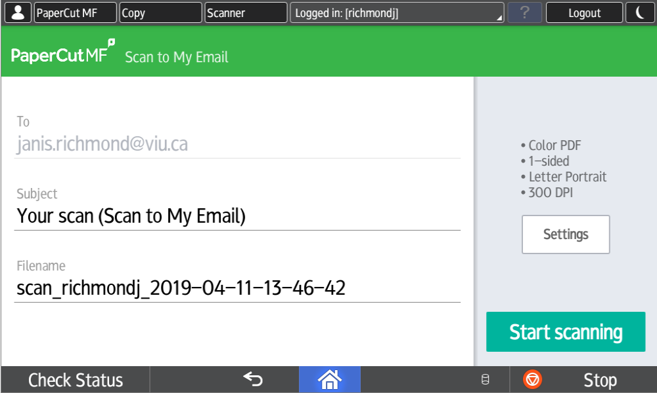
Scan to Me
Step 2
Customize Your Info
Subject – select box and enter a personal subject line or leave the default.
Filename – select box and enter a new name for your file or keep the default.
Press Scan setting to change the default settings
OR
Press Start Scanning

Slide 22
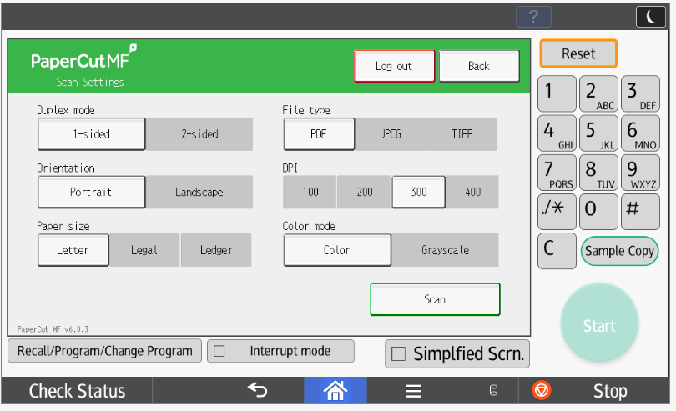
Scan to Me
Step 3
Scan Settings
Select Settings to Change for your scan
Duplex Mode (Single or 2-Sided)
Orientation – Portrait or Landscape
Paper Size – Letter, Legal Ledger
File Type – PDF, JPEG, TIFF
DPI – 100 to 600 DPI (dots per Inch)
Colour Mode – Colour, Grayscale or BW
PRESS SCAN to SEND Your Document

Slide 23
Ricoh Scanning

Slide 24
Ricoh Scan
Tap your card on the card reader at the Ricoh device OR Login manually with your username and password.
Press the Device Functions button in the PaperCut screen.

Slide 25
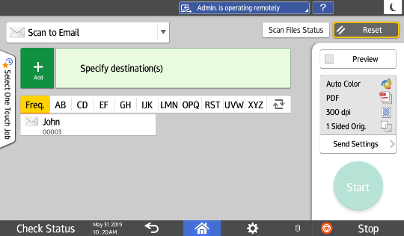
Scan to Email
Choose Scanner Select Your Name. Press Start.

Slide 26
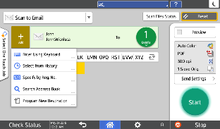
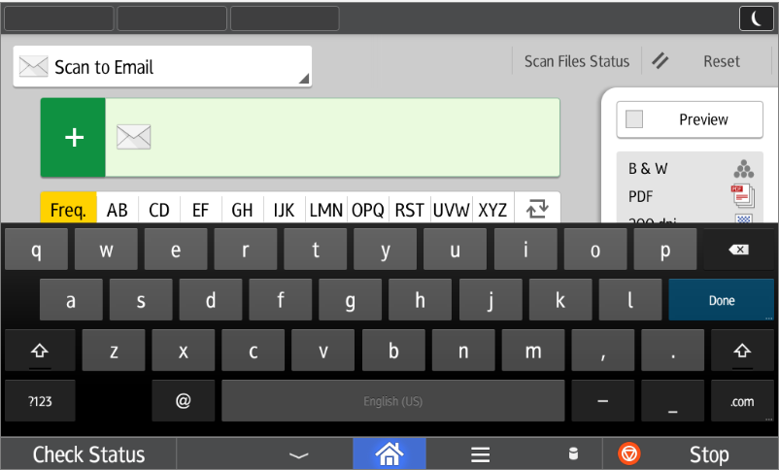
Specify Destination
Select from a pre-programmed destination or
Press “+” for drop down menu.
And press Enter Using Keyboard
Press Done after entering an email address.

Slide 27
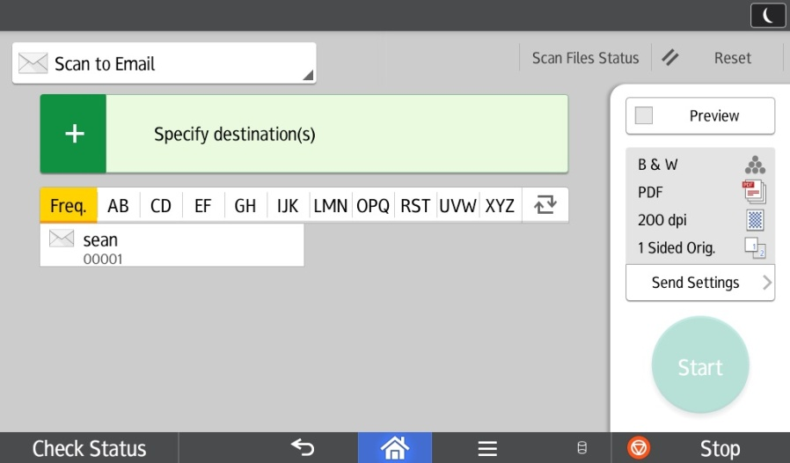
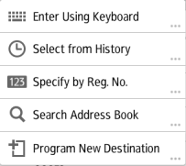
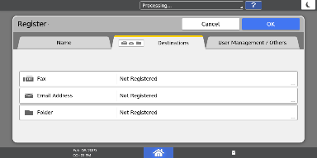
Program New Destination
Select Program New Destination to add a quick key contact
Enter an Email address in the Email Address field
Press the Name tab and enter a name.
Press OK to save.

Slide 28
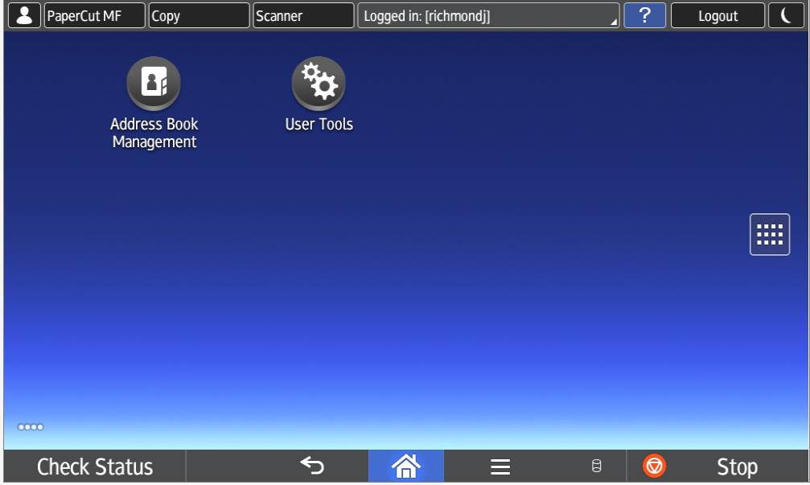
Edit/Delete Contact
If you need to Edit/Delete someone from the address book, go to Home Page and Select Address Book (you may need to flip to the second page of screen).

Slide 29
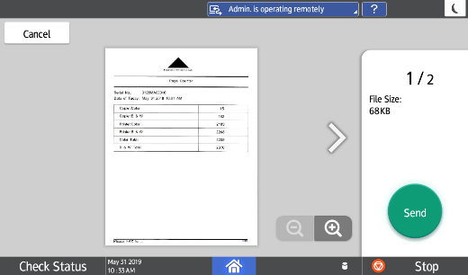
Preview
Preview will show a full-page image of your scanned document.

Slide 30
Scan Defaults
Defaults for scanning will appear here.
Press Send Settings to adjust.

Slide 31
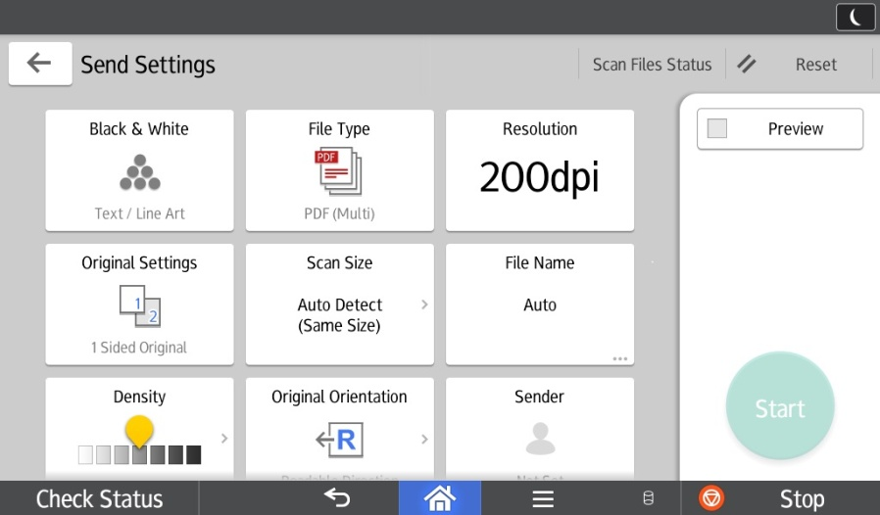
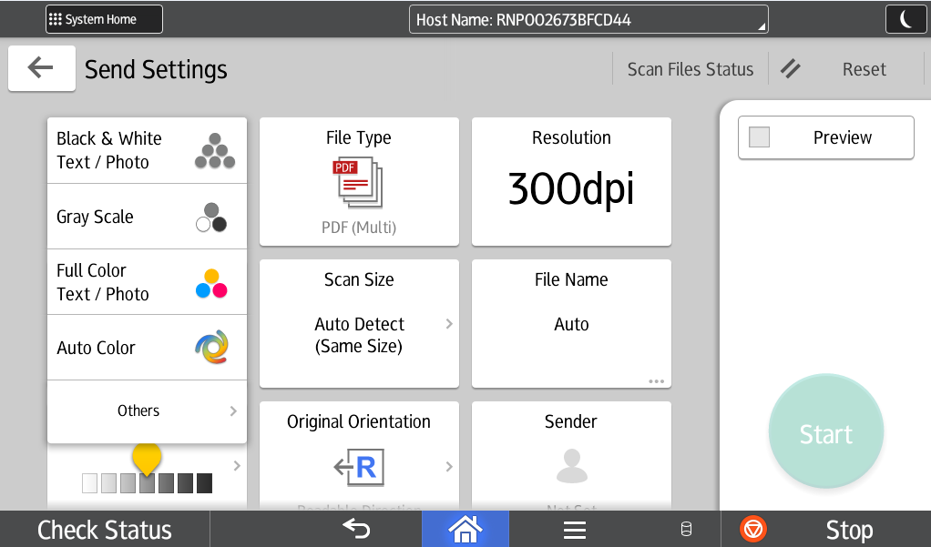
Colour & File Type Options
Choose from color options.
File Type Options: Multi Page- sends documents as a single attachment.
Single Page: sends documents as multiple attachments.

Slide 32
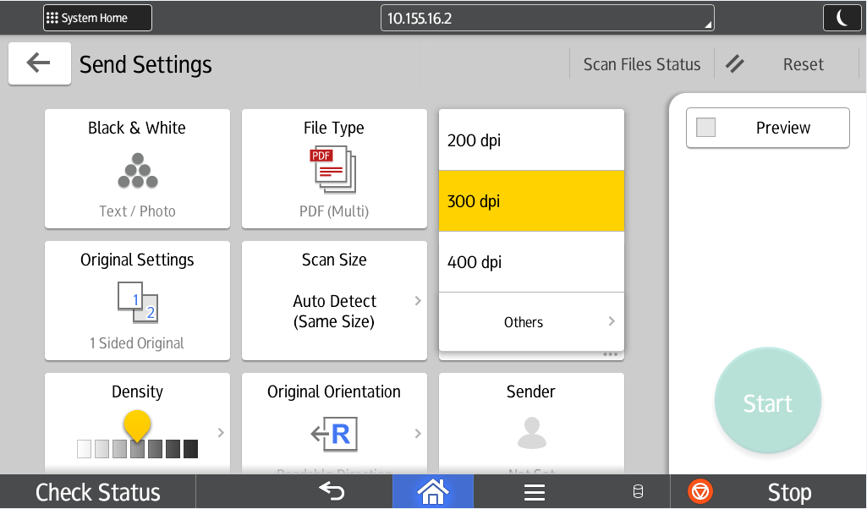
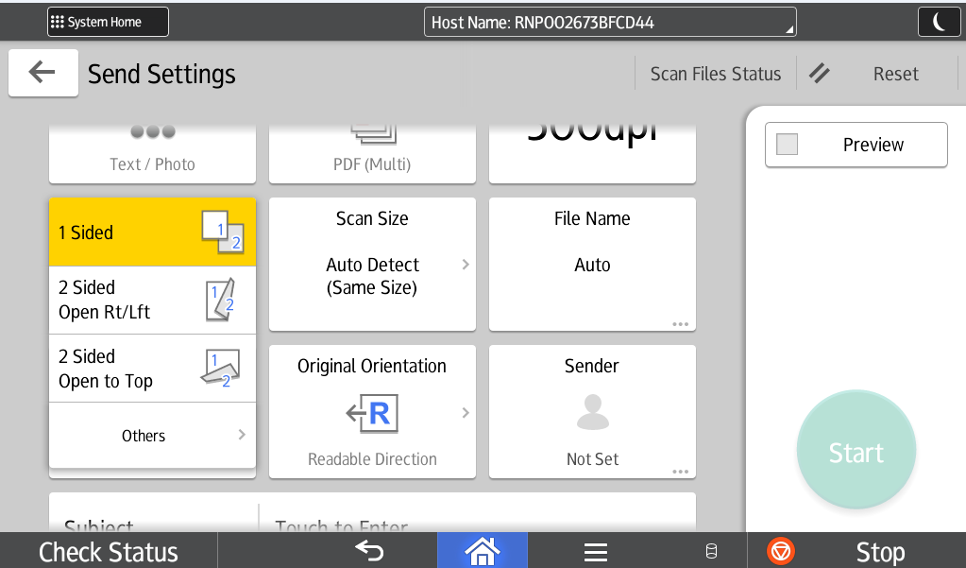
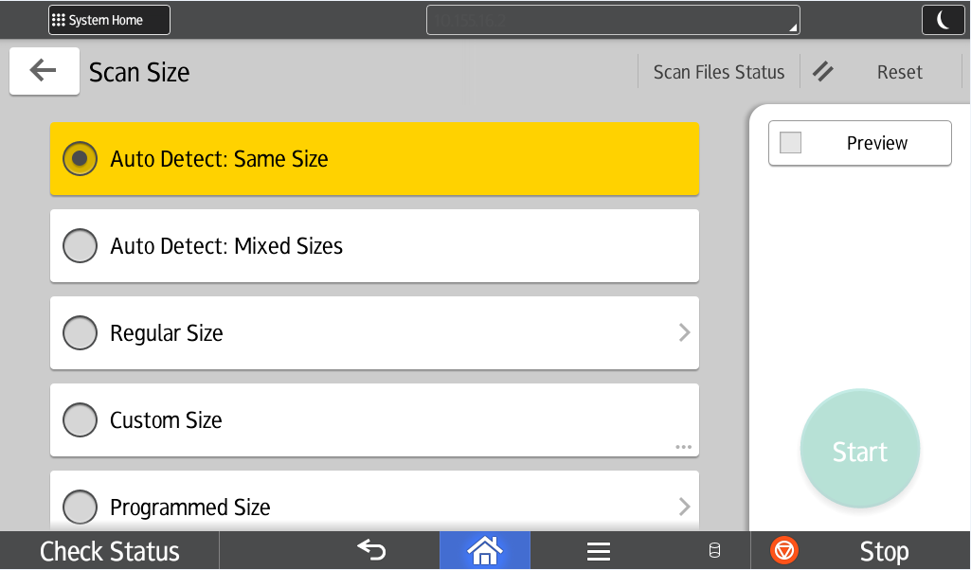
Original Settings & Size
Choose from 1 sided, 2 sided open RT/ Lft, or 2 sided Top to Top.
Choose from Auto Detect : Same Size, Auto Detect : Mixed Sizes, Regular Size, Custom Size, and Programmed Size.

Slide 33
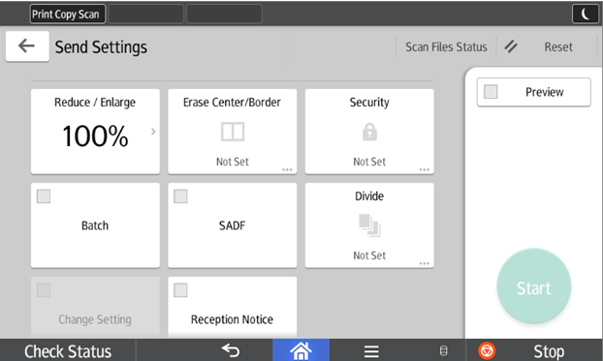
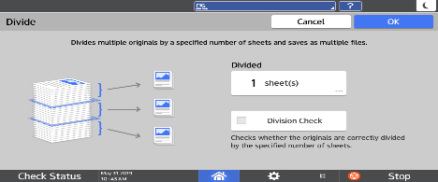
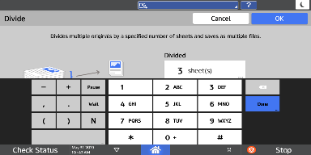
Divide
To split up multiple pages into smaller PDF’s, press Divide.
Press the Divided box.
Enter the number of pages for division and press Done. Press OK.

Slide 34
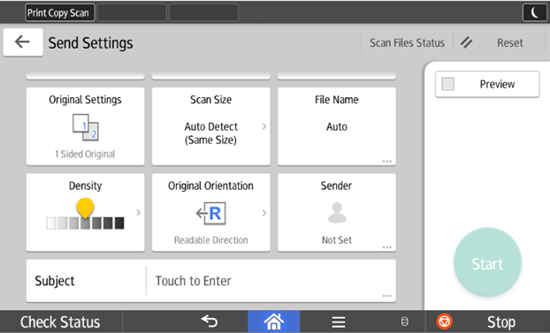
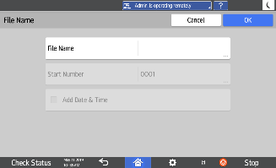
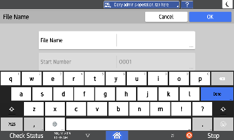
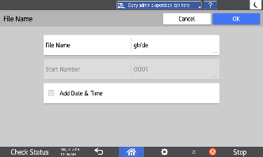
Changing the File Name
Name your file by selecting File Name.
Touch the File Name field
Type in the name you want to call your file and press Done.
Press OK.

Slide 35
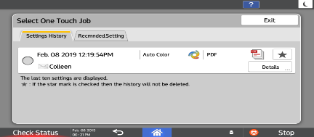
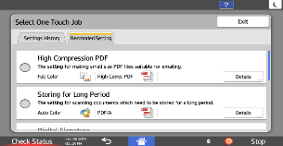
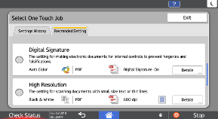
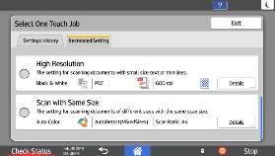
One Touch Job
Settings History will show the last 10 uses of the device and what settings were chosen.
Recommended Setting will show some optimal settings for special scan projects.

Slide 36
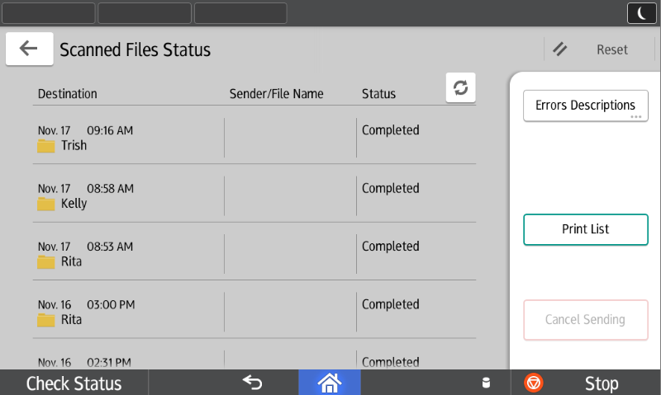
Scan File Status
Scan File Status: View status of a job or cancel a scan if status is pending.

Slide 37
Copy

Slide 38
Copy
No need to tap card or login
Press Copy Button On Home Screen
You can use Copy or Copy Classic Button

Slide 39
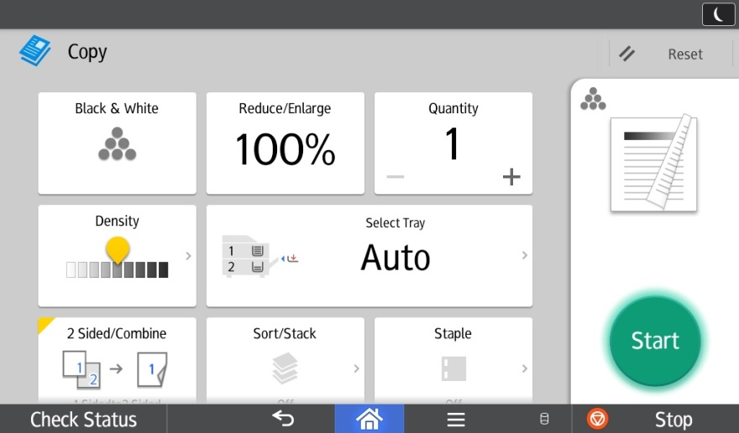
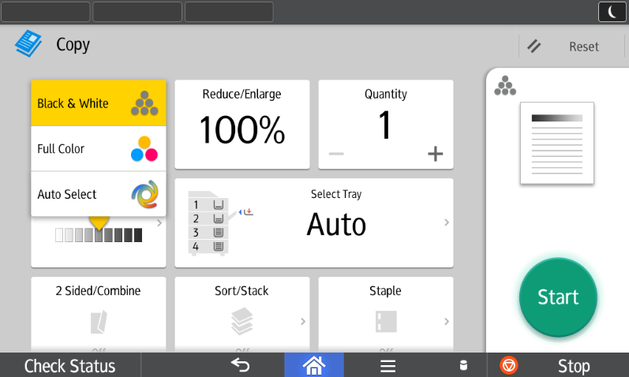
Colour or B&W
To choose Color Copying Press Black & White, With the drop down screen you can choose Full Color, Auto Color Select when copying mixed colour and b&w documents.

Slide 40
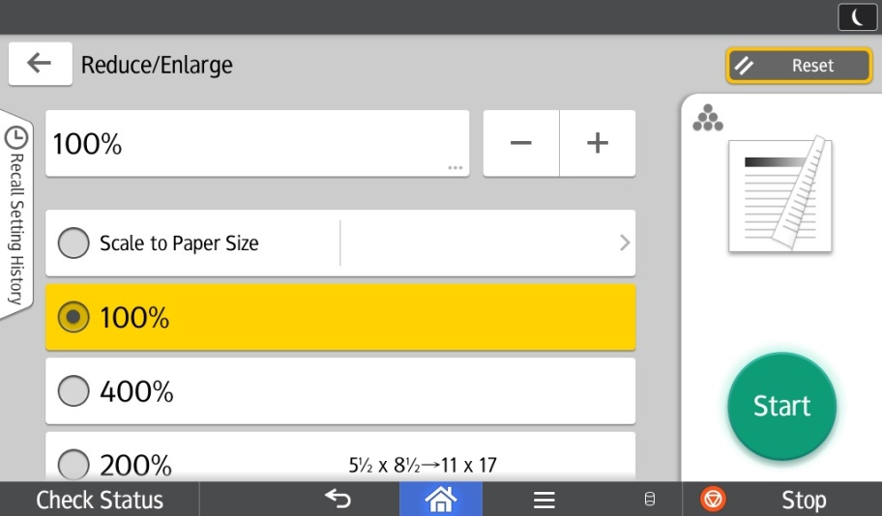
Reduce/Enlarge
This option allows you to choose presets from 25 to 400%, Zoom in 1% increments with + or -, or enter your percentage directly with Number Keys.
You can also choose Scale to Paper Size to allow the device to decide how to reduce or enlarge to a particular size that you choose.

Slide 41
Quantity & Sort/Stack
Quantity: Select how many copies you would like to make.
Sort/Stack: You can turn on SORT to collate documents.
Density: Lighter or Darker
Select Tray: choose a paper tray or bypass

Slide 42
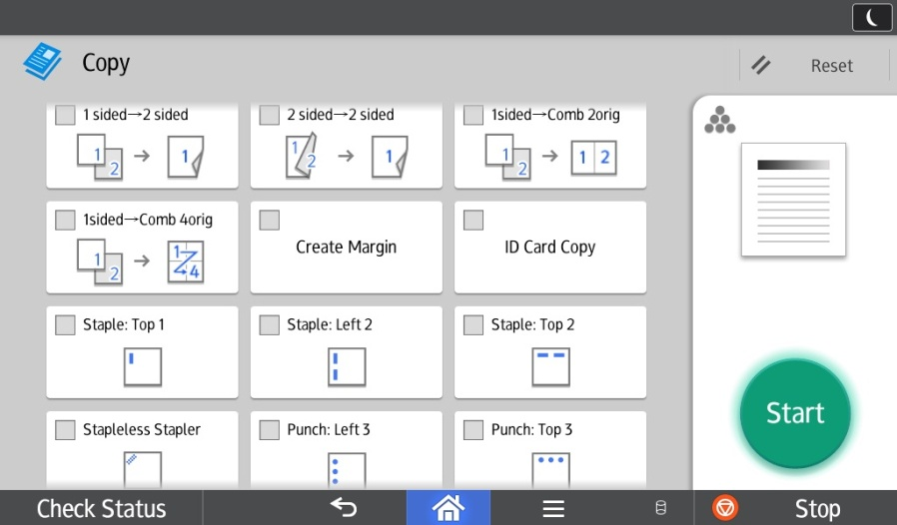
2 sided
Press 2 Sided/Combine
Or
Scroll Down for the Quick Buttons

Slide 43
Staple – Hole Punch
Press Staple or Hole Punch
Or
Scroll Down for the Quick Buttons
Or Finishing for more options

Slide 44
Original Size & Original Type
Original Size: allows you to select Mixed Sizes when your document has various page sizes in it.
Original Type: allows you to set the type of document to be copied, or choose Text, Text photo. Generation Copy, Light or Map for image repair.
Generation Copy – For originals that have been copied repeatedly. Will lighten the text and straighten out lettering.
Light – For originals containing light text. Will darken lighter text on a page only.
Map – For originals containing maps. Will darken faint lines on maps or drawings.

Slide 45
Create Margin
Create margin: allows you to shift wide image on document to allow for hole punching without losing important information of the document

Slide 46
Quick Buttons: 2 sided - Staples - Hole Punch options
Scroll down
2 Sided quick buttons
Stapling - 4 quick buttons
Hole Punch - 2 quick buttons

Slide 47
Status-Misfeeds-Maintenance-Supplies -

Slide 48
Check Status
The Check Status light will come on in red if there is a paper misfeed or if there is something else going on with the device.

Slide 49
Check Status
When the light under Check Status is lit, press the icon to resolve the problem. Next to the function, the device indicates the reason for the error.

Slide 50
Clearing a Misfeed
Follow the indications on the screen that show you step-by-step how to remove the misfed paper.

Slide 51
Clearing a Misfeed
Section Y
Sections B and C
Always remove the misfed paper in the same direction as the feed rollers.
Do not pull sideways as the paper will tear and the rollers will wear.

Slide 52
Finisher Misfeeds
Section R (1000-sheet finisher)

Slide 53
Feeder Misfeed
To lift top of the document feeder, pull up on the handle.
Push the grey latch to access the paper from the inside.

Slide 54
Document Feeder
The three sensors on the feed table should not be blocked by paper, etc. It will result in undesired paper size output, or the unit will beep indicating to load special paper size in the tray.

Slide 55
Cleaning the Glass
A- Series Document Feeder
Cleaning the glass: a cloth is supplied with your unit.
Please clean the scan glass and exposure glass frequently (about once every 2 weeks), or when you notice lines or spots on your copies.

Slide 56
Cleaning the Slit Glass
Remove the blue cleaning wand from its slot in the front panel.
At an angle, slide it in and out, a few times, in each of the 4 color slots as indicated by the brush sticker. This should be done every 2 months, to prevent dust build-up on the slit glass, which causes the laser to malfunction, and white streaks as a result

Slide 57
Changing Toner, Waste Toner Cartridge and Staple Cartridges

Slide 58
Replacing the Toner
Open the front panel and remove the used cartridge.
Shake the new cartridge LIGHTLY vertically (see inside panel), unscrew the cap, and insert it into the toner unit with the arrow on top.
NEVER REMOVE, SHAKE AND RE-INSERT THE USED CARTRIDGE.
When the System Message box shows toner bottle empty, it is time to change the toner cartridge. You can still print up to 300 pages in this state.

Slide 59
Changing the Toner - BW
Open the front panel and remove the used cartridge.
Shake the new cartridge LIGHTLY vertically (see inside panel), unscrew the cap, and insert it into the toner unit with the arrow on top.
NEVER REMOVE, SHAKE AND RE-INSERT THE USED CARTRIDGE
When the Add Toner message appears under Check Status, it is time to change the toner cartridge.

Slide 60
Replacing Staples
Following the instructions on the display or box of staples, push the stapling unit to the left, pull out the casing, remove the empty cartridge, and insert a new one.
Type T
500-sheet Finisher (SR3130): when the Staple icon (bottom left of screen) flashes, it is time to change the staple cartridge.

Slide 61
Replacing Staples
Following the instructions on the display or the box of staples, remove the cartridge from the casing and insert a new one
Type T
2000-sheet Booklet Finisher (SR3160-70): when the Staple icon (bottom left of the screen) flashes, it is time to change the staple cartridge with a refill.

Slide 62
Replacing Staples
Pull out the stapling unit by its handle. The staple cartridge is located on the left side, on the bottom of the unit
Type W
2000-sheet Booklet Finisher (SR3160-70): when the Staple icon (bottom left of the screen) flashes, it is time to change the staple cartridge

Slide 63
Replacing Staples
Type s
Type k
1000-sheet Booklet Finisher (SR3150)

Slide 64
Waste Toner Cartridge (colour copiers only)
A message will appear in the System Message box that will let you know when the waste toner cartridge is getting full.
To change cartridge, open the door next to Tray 1, remove full container and replace with an empty one.
Please order an extra cartridge with supplies (free with contract). If using @remote the waste toner cartridge will be automatically sent out.
Please recycle through our toner recycling program.

Slide 65
Returning Cartridges
To return your empty toner cartridges and full toner waste cartridges to Ricoh, simply go to the Ricoh website and move the mouse over the Products title. Then select Toner Bottle and Cartridge Return Program. Follow the instructions to print off a mailing or courier label.
https://www.ricoh.ca/en/about-us/corporate-responsibility-and-environmental-sustainability/product-stewardship-and-recycling

Slide 66
@Remote
You are registered with @Remote
Your first set of toner and waste toner bottle has been ordered.
For other consumables such as staples please use the same process as before.
After changing the toner cartridge once, @Remote will send a signal to Ricoh, and a new cartridge will be shipped to you, and thus, for the duration of the contract.

Slide 67
Placing a Service Call
To place a service call, please call
the phone number that is on the Ricoh sticker on the front of your device
Please have your serial number handy when calling.
If you are registered with MyRicoh.ca you can submit a service call on the web site

Slide 68
Rebooting Machine
To reboot: Press the main power button, Machine will do a shut down. When shut down count to 10 and press the main power button to start up machine.

Slide 69
Thank You

